Slide 1


Sexually Transmitted Disease Reporting
Webinar for Providers
Monica Kowalczyk
STD Surveillance Specialist Intern
Notes:
Hello, and welcome to the STD Reporting Webinar for Providers. My name is Monica, and I am a STD Surveillance Specialist interning with the Kane County Health Department. This webinar addresses fundamentals of provider STD reporting, and specifically, Illinois’ National Electronic Disease Surveillance System as the recommended method of reporting STD cases and treatment. This webinar also assists providers in gaining access to the I-NEDSS STD reporting database.
Accessible links are available throughout this webinar as content is discussed, as well as at the end of the presentation.

Slide 2

PART 693 - CONTROL OF SEXUALLY TRANSMISSIBLE INFECTIONS CODE
Reportable STIs & Lab Results
STI Provider Reporting
Fines & Penalties
Counseling & Partner Services
Physical Exam & Medical Treatment for STIs
Expedited Partner Therapy
Notes:
Part 693 Control of Sexually Transmissible Infections Code, contains detailed information on topics discussed in this webinar, specifically
reportable STIs & lab results in section 20,
STI provider reporting in section 30,
Fines & penalties for failure to report in section 35,
Counseling & partner services in section 40,
Physical examination and medical treatment of STIs such as syphilis, gonorrhea & chlamydia in section 50,
and expedited partner therapy in section 150.

Slide 3
Disease Surveillance & Follow-up
Reportable STDs
Quickly Identify diseases requiring immediate intervention
Detect changes in trends or patterns in disease occurrence
Identify at-risk communities/population groups that require targeted public health response
Assess strategies, evaluate outcomes, and determine success, of control and prevention interventions
Chlamydia
Gonorrhea
Syphilis
Chancroid
Lymphogranuloma Venereum (LGV)
Notes:
The purpose of conducting disease surveillance and follow-up on reportable STDs such as, Chlamydia, Gonorrhea, and Syphilis,
Is to quickly Identify diseases that may require immediate public health intervention,
To detect changing trends or patterns in disease occurrence,
To Identify at-risk communities and population groups that require targeted, public health response as a result of changes detected in disease patterns,
And to assess strategies, evaluate outcomes, and determine success of control and prevention interventions

Slide 4
How LHDs use Provider-Reported STD Information
Control Sources of Exposure
appropriate treatment provided to all STD-positive cases
Prevent the Spread of STDS
Assist IDPH Surveillance & Epidemiological Monitoring
Complete disposition requirements & send closed investigations to IDPH
case analysis
contact tracing & partner services
education & counseling
linkage to care
Notes:
Local health departments, or LHDs, use information reported by providers,
* to control sources of exposure, by ensuring appropriate treatment is provided and reported for STD-positive cases,
To prevent the spread of STDs, through case analysis, contact tracing & partner services, education & counseling, and linkage to care,
And assist with IDPH surveillance & epidemiological monitoring of STDs, by completing dispositions requirements, and sending closed investigations to IDPH, who reports regional, state, and national STD metrics

Slide 5
How CDC uses Provider-Reported STD Information
CDC receives National Notifiable Diseases Surveillance System (NNDSS) data in multiple formats from state and territorial health departments and combines these data streams into unified datasets for CDC programs.
CDC programs use disease-specific data to
Recognize disease outbreaks
Track disease spread at state, regional, and national levels
Identify geographic areas of concern and inform state decision makers
Identify high-risk groups
Assist state and local public health departments better control disease by
Evaluate and fund disease control activities
Notes:
CDC receives National Notifiable Diseases Surveillance System data in multiple formats from state and territorial health departments, and combines these data streams into unified datasets for CDC programs.
CDC disease programs use disease-specific data
to Recognize disease outbreaks
to Track the spread of disease at state, regional, and national levels
to Identify geographic areas of concern and inform state decision makers
to Help state and local public health departments better control disease by identifying groups most at risk
and to Evaluate and fund disease control activities

Slide 6
How CDC uses Provider-Reported STD Information cont.
CDC provides case surveillance resources and guidance to patients, healthcare teams, and public health agencies.
Health information for patients (websites, fact sheets, toolkits)
Guidance to healthcare teams (clinical information, research, publications like Morbidity and Mortality Weekly Report (MMWR),
Support to public health agencies (guidance, data collection and reporting, large and small-scale outbreak assistance, and funding)
Notes:
CDC provides case surveillance resources and guidance to patients, healthcare teams, and public health agencies, by
providing Health information for patients through websites, fact sheets, and toolkits,
providing Guidance to healthcare teams through clinical information, research, and publications such as Morbidity and Mortality Weekly Reports,
And providing support for public health agencies through guidance, data collection, reporting, and funding

Slide 7
Sexual History and Physical Examination
Prevention
Partner Services (notification & care of sex partners; EPT)
Screening
Evaluation of STD-related Conditions
Laboratory Tests
Treatments
Education on preventing new infection
Recommendations for Providing Quality STD Clinical Services (STD QCS)
Notes:
Recommendations for providing quality STD clinical services include,
sexual history and physical exam,
Prevention,
Partner Services,
Screening,
Evaluation of STD-related Conditions,
Laboratory Tests,
Treatments,
And education on preventing new infection

Slide 8

Importance of Treatment & Current Practice Standards
The most important intervention for all STDs is treatment.
It is critical that treatment is provided and reported in accordance with current practice standards:
2021 STI Treatment Guidelines
2022 IDP Morbidity Report of STIs
2022 STD Treatment Codes
Expedited Partner Therapy (EPT)
2021 STI Treatment Guidelines | 2022 STI Morb Report & Rx Codes | Expedited Partner Therapy
Notes:
The most crucial and effective intervention for all sexually transmitted diseases is treatment. Treatment prevents the spread of disease and worsening of symptoms. It is crucial to treat cases in accordance with current practice standards, including Treatment Guidelines, Morbidity Reports, Treatment Codes, and Expedited Partner Therapy Services.

Slide 9
Updated Treatment Guidelines
2021 STI Treatment Guidelines comprises current, evidence-based prevention, diagnostic and treatment recommendations as a source for clinical guidance
*2021 treatment guidelines replace those of 2015
2021 STI Treatment Guidelines | 2022 STI Morb Report & Rx Codes | Expedited Partner Therapy
Notes:
CDC’s Sexually Transmitted Infections (STI) Treatment Guidelines, 2021 provides current evidence-based prevention, diagnostic and treatment recommendations that replace the 2015 guidance. The recommendations are intended to be a source for clinical guidance. Healthcare providers should always assess patients based on their clinical circumstances and local burden. A copy of the 2021 treatment guidelines can be access by clicking the link on the bottom of your screen.

Slide 10
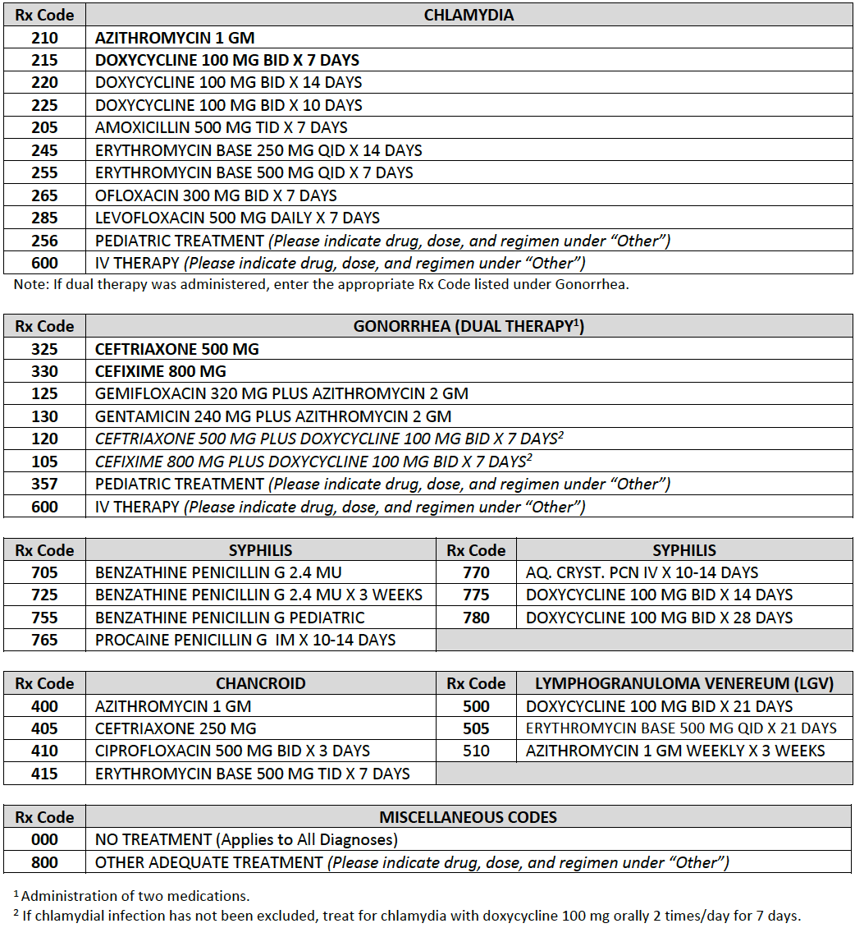
Updated Treatment Codes
*2022 treatment codes replace those of 2018
2021 STI Treatment Guidelines | 2022 STI Morb Report & Rx Codes | Expedited Partner Therapy
Notes:
These are the current treatment codes to be used for the treatment of positive STD cases that replace those of 2018. A copy of the updated treatment codes can be access by clicking the link on the bottom of your screen.

Slide 11
Expedited Partner Therapy (EPT)
The clinical practice of treating the sex partners of patients diagnosed with chlamydia or gonorrhea by providing prescriptions or medications to the patient to take to his/her partner without the health care provider first examining the partner.
EPT Works
standard of care and endorsed by CDC
proven to reduce re-infection rates and possible health complications
effective tool to combat the rising STD rates
useful option to facilitate partner treatment
2021 STI Treatment Guidelines | 2022 STI Morb Report & Rx Codes | Expedited Partner Therapy
Notes:
Expedited Partner Therapy, or EPT, is the clinical practice of treating the sex partners of patients diagnosed with chlamydia or gonorrhea, by providing prescriptions or medications to the patient to take to his/her partner without the health care provider first examining the partner
EPT is considered the standard of care and is endorsed by CDC. EPT is proven to reduce re-infection rates and possible health complications,
is useful for facilitating partner treatment,
and an effective tool to combat the rising STD rates.

Slide 12
Date(s) treated
Rx code(s)
Treatment facility
Expedited partner therapy (yes/no)
Attempts to notify patient of positive test
Reporting Patient Info
Reporting Treatment
Patient first & last name
Residential address
DOB
Phone number
Race
Ethnicity
Sex at birth
Current gender
Sex of sex partner(s)
For female patients - whether they are pregnant, and if so, estimated due date
2021 STI Treatment Guidelines | 2022 STI Morb Report & Rx Codes | Expedited Partner Therapy
Notes:
Complete and accurate treatment information is required for disposition. Required information includes
* Treatment date(s),
Medical prescription code(s),
Facility where the patient was treated,
Whether expedited partner therapy was given,
And if provider attempts to notify the patient of their positive test were unsuccessful.
It is also important to obtain complete and accurate patient information, including,
First and last name,
Residential address,
Date of birth,
Phone number,
Race & Ethnicity,
Sex at birth & Current gender,
Sex of sex partner(s),
And for female patients, whether they are pregnant, and if so, their estimated due date.

Slide 13


Reporting Options
Illinois' National Electronic Disease Surveillance System
IDPH Morbidity Report Form
Notes:
There are two methods available to providers for reporting results and treatment of positive Chlamydia and Gonorrhea cases. Either by filling out the morbidity form, or directly into I-NEDSS.

Slide 14
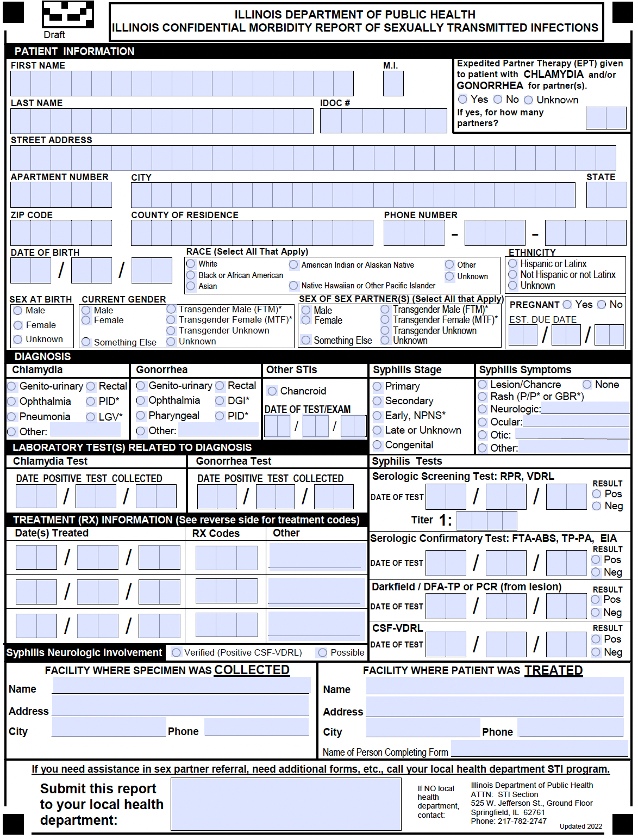
IDPH Morbidity Report of Sexually Transmitted Infections fax: (630) 897-8128
2021 STI Treatment Guidelines | 2022 STI Morb Report & Rx Codes | Expedited Partner Therapy
Notes:
Reporting results and treatment for all positive STD cases, is required of all physicians, labs and blood banks, under the Illinois Control of Sexually Transmitted Diseases Administrative Code 693.
Providers who do not report through I-NEDSS, must manually fill out this morbidity report form and fax the report to their local health department. Providers who use I-NEDSS, do not need to manually fill out or fax this morbidity form. Rather, they report positive STD results and treatment directly to their local health department through I-NEDSS.

Slide 15
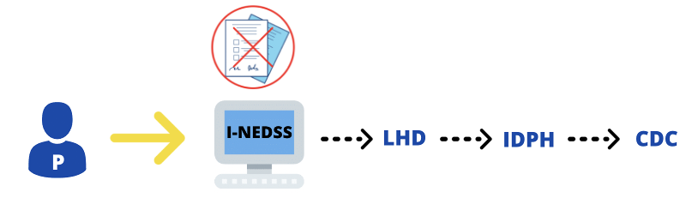
STD Reporting Methods Diagram
Reporting through I-NEDSS replaces forms and faxing by enabling providers to report positive results & treatment directly into the disease surveillance system
Notes:
The information you report as the provider, is the same, regardless of reporting method. However, reporting through I-NEDSS replaces forms and faxing, by enabling providers to report positive results and treatment directly into the disease surveillance system.
Once a report is entered, it is immediately routed to the appropriate local health department for additional follow-up. Once all required information is obtained for a case, the appropriate local health department closes and sends the investigation to IDPH, who then sends information about national notifiable diseases to the CDC.

Slide 16
What is I-NEDSS?
Illinois’ National Electronic Disease Surveillance System (I-NEDSS) is a secure, Web-based application available to health care providers and other reporters for input of demographic, medical and exposure information on patients diagnosed with reportable conditions.
2021 STI Treatment Guidelines | 2022 STI Morb Report & Rx Codes | Expedited Partner Therapy
Notes:
Illinois’ National Electronic Disease Surveillance System, or I-NEDSS, is a secure, Web-based application available to health care providers and other reporters, for input of demographics, and medical and exposure information on patients diagnosed with reportable conditions.

Slide 17
Why Use I-NEDSS?
Optimizes STD reporting process
Replaces manual forms & faxing
Allows sensitive information to be shared safely & efficiently between providers & LHD
Allows sensitive information to be shared safely & efficiently with IDPH & CDC
2021 STI Treatment Guidelines | 2022 STI Morb Report & Rx Codes | Expedited Partner Therapy
Notes:
The reporting process has been optimized for both providers and local health departments through I-NEDSS, which replaces forms and faxing, and allows sensitive information to be shared safely and efficiently between providers and local health departments, as well as with IDPH and the CDC.
The remainder of the webinar will help interested providers gain access into I-NEDSS.

Slide 18
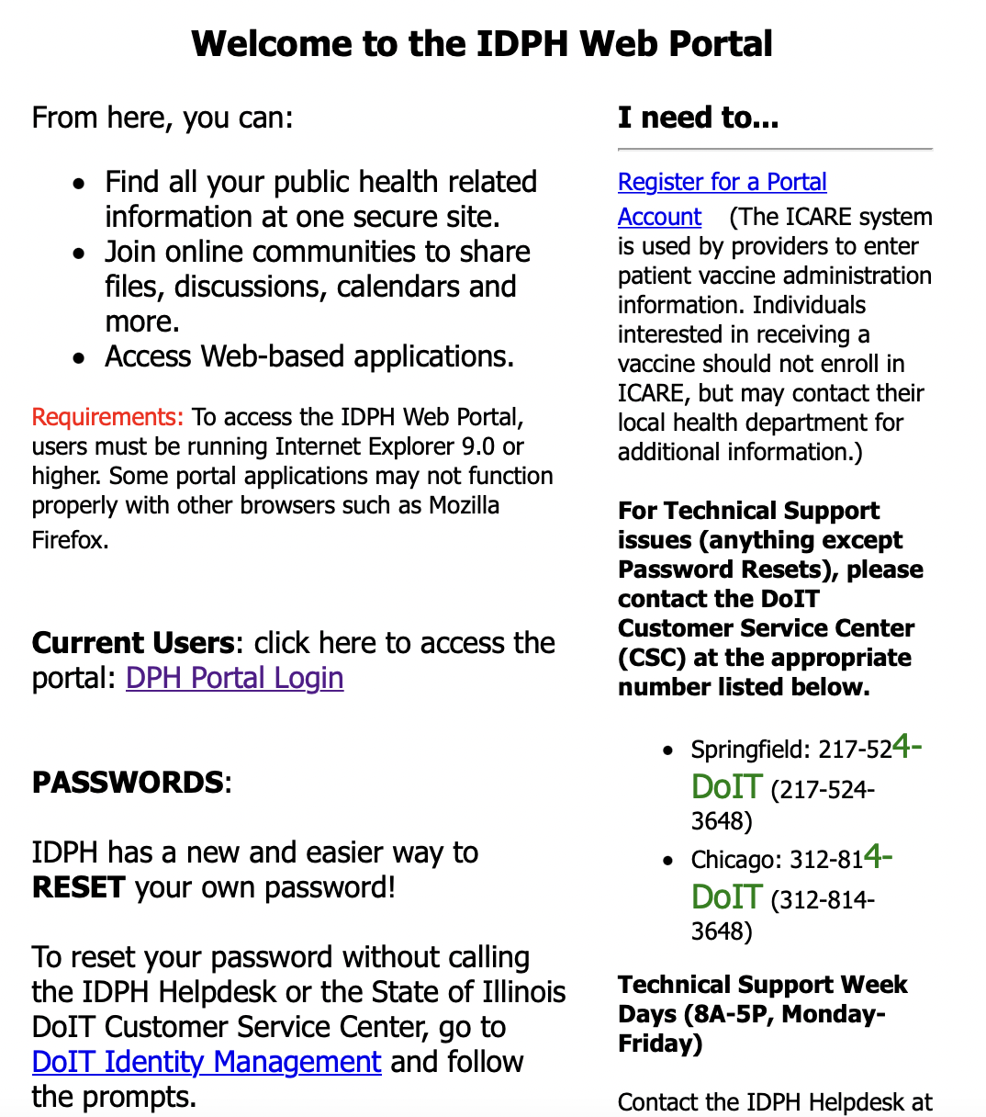

Register for I-NEDSS
IDPH Web Portal
Notes:
To register for an I-NEDSS account, go to www.idphnet.Illinois.gov, or simply click on the IDPH web portal link, and click Register for a Portal Account under “I need to…”.

Slide 19
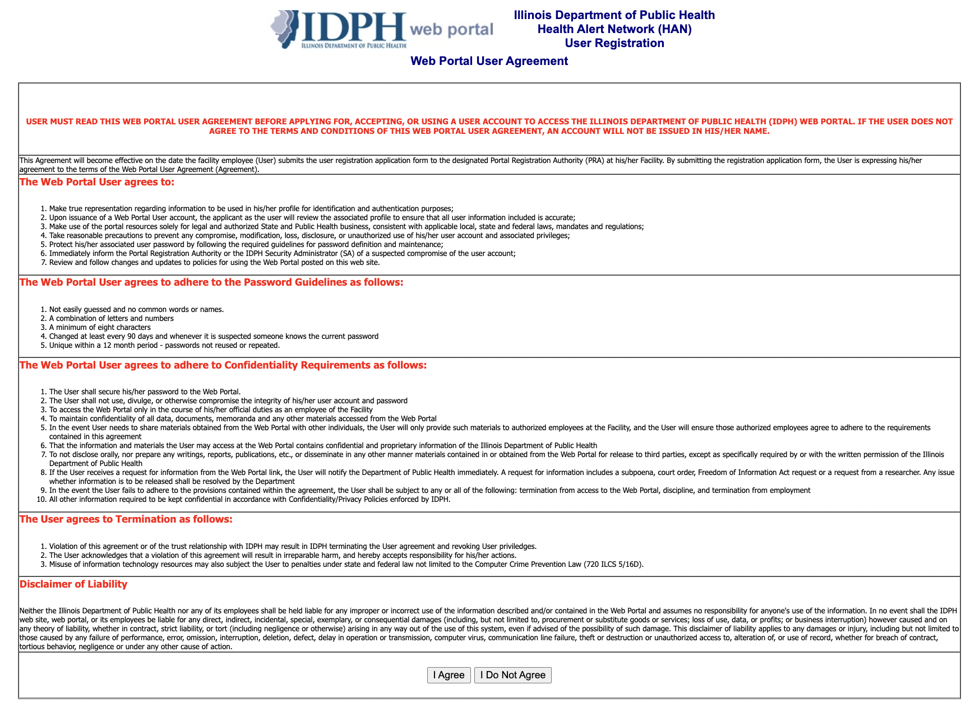
IDPH Web Portal User Agreement
Notes:
Users must read and agree to the IDPH Web Portal User Agreement in order to proceed with registration.

Slide 20
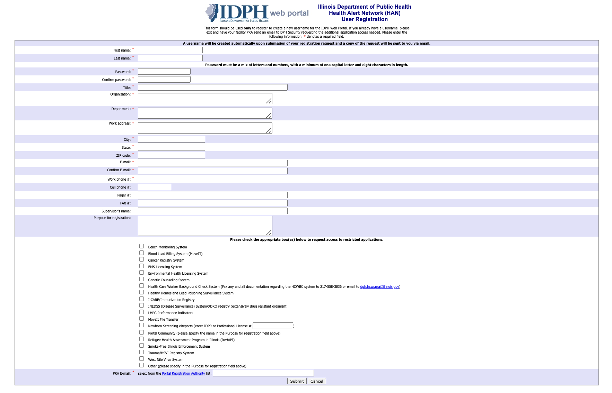
IDPH Web Portal User Registration Form
Portal Registration Authority (PRA) List
I-NEDSS reporting STI treatment to LHD
Notes:
Next, complete all required fields on the IDPH Web Portal User Registration Form. Be sure to indicate the purpose for registration, as I-NEDSS reporting STI treatment to LHD. Prior to submitting this form, a Portal Registration Authority email must be provided.
To verify your organization’s PRA status, search for your organization through the Portal Registration Authority List. Select a PRA from your organization: click on a name to select, then the Close button after selection. If you can't find your organization, search IDPH & select IDPH / DPH SECURITY. If your organization does not have PRA, DPH Security will work with you to establish a PRA for your organization.
Once you have all required fields , click Submit at the bottom of the page. A username will be created automatically, upon submission of your registration request, and a copy of the request will be sent to your email.

Slide 21
KCHD Communications
KHDC will
Run monthly case reports to identify positive-STD cases that are missing report of treatment
Conduct follow-up with providers who have cases pending report of treatment for any positive chlamydia / gonorrhea lab results received
KCHD STD Surveillance Specialist
Adriana Posada | posadaadriana@co.kane.il.us | phone (630) 444-3099 | fax (630) 897-8128
Notes:
The Kane County Health Department will
Run monthly case reports to identify positive-STD cases that are missing report of treatment,
and conduct follow-up with providers who have cases pending report of treatment for any positive chlamydia / gonorrhea lab results received

Slide 22
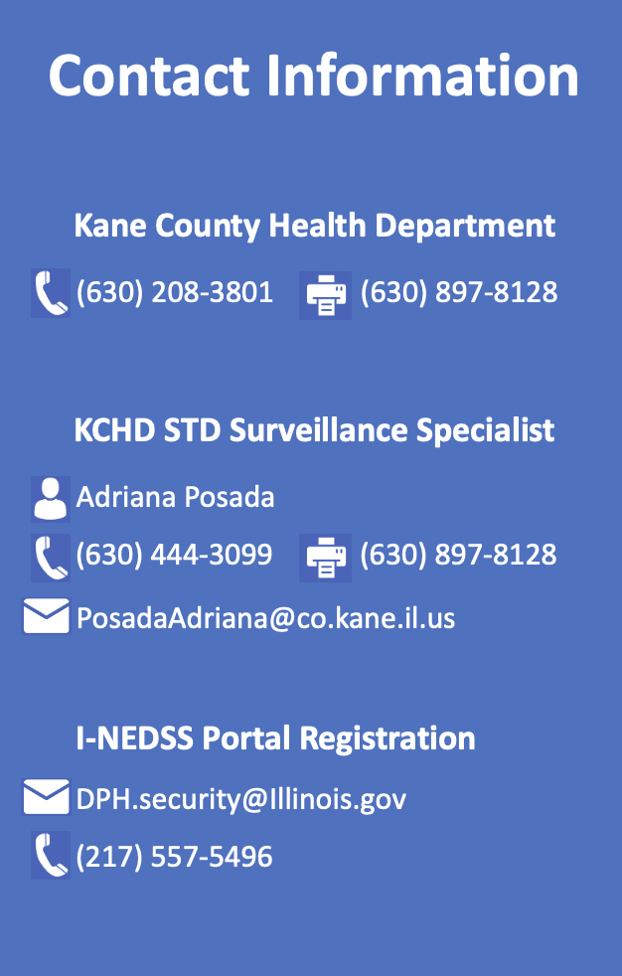




Contact Information
Kane County Health Department
(630) 208-3801 (630) 897-8128
KCHD STD Surveillance Specialist
Adriana Posada
(630) 444-3099 (630) 897-8128
PosadaAdriana@co.kane.il.us
I-NEDSS Portal Registration
DPH.security@Illinois.gov
(217) 557-5496
Referenced Links
Current Practice Standards
2021 STI Treatment Guidelines
2022 STI Morb Report & Rx Codes
Expedited Partner Therapy
PART 693 - CONTROL OF SEXUALLY TRANSMISSIBLE INFECTIONS CODE
Recommendations for Providing Quality STD Clinical Services (STD QCS)
I-NEDSS
Illinois’ National Electronic Disease Surveillance System (I-NEDSS)
IDPH Web Portal
Web Portal User Agreement
Notes:
The Kane County Health Department is more than happy to assist and support providers in using I-NEDSS reporting. Questions regarding technical assistance for I-NEDSS should be directed to DPH Security.
Links provided throughout the webinar are added here for your convenience.

